Slide 1

The File System
King.Zevin@ADSLab
Notes:
大家好,我叫金泽文.刚加入实验室,这是我第一次讲paper.我非常紧张.
对于这篇gfs,我相信师兄师姐们可能都不只读了一遍.可能对一会儿我讲的时候有听不清的或者质疑的地方,或者有其他新颖的想法,欢迎指出,欢迎打断.我感觉有打断这次reading group才有意义.谢谢大家

Slide 2
Outline
Motivation
Assumptions
Questions
Measurements
Benefits/Limitations
Conclusion
Notes:
我今天讲gfs是主要是按照问答形式,假设自己是当时gfs的设计者,提出一些问题,并解决一些问题,如此迭代,最后得到整个gfs的设计思路
显示动机motivation

Slide 3
Motivation
Need for a scalable DFS
Large distributed data-intensive applications
High data processing needs
Performance, Reliability, Scalability and Availability
More than traditional DFS
Notes:
为什么要设计gfs呢?
首先我们的数据量很大,需要可扩展的分布式文件系统
我们的应用主要是大规模分布式数据密集型的
我们有大量的数据处理的需求
在此之上,我们当然要高性能,可信度,灵活性和高可用性.
最后我们应该彻底颠覆传统的dfs

Slide 4
Assumptions
Assumptions – Environment
Assumptions – Applications
Notes:
针对我们的motivation,
以及现在的客观条件.
我们提出刻画出一些assumption,方便设计gfs
分别是从环境和应用的角度

Slide 5
Assumptions –
Environment
Commodity Hardware
  inexpensive
TBs of Space
  must support TBs of space
Component Failure
  the norm rather than the exception
Notes:
客观环境-我们用的是廉价的商用硬件
这样就有一个问题,我们用的是大量的,廉价硬件,所以failure应该认为是常态而不是意外
另外我们的空间必须支持tb级别的数据

Slide 6
Assumptions –
Applications
Multi-GB files
  Common
Workloads
  Large streaming reads
  Small random reads
  Large, sequential writes that append data to file
  Multiple clients concurrently append to one file
High sustained bandwidth
  More important than low latency
Notes:
对于应用的情况,是这样的
Gb级别的文件很常见,大部分都是几百MB,或者几GB.
然后我们的操作主要是large streaming reads和small random reads
我们的写呢,主要是large sequential append. random write很少,我们不用刻意优化
我们经常会有并发append到同一个文件的情况
另外,我们的应用更需要高带宽而不是低延迟,对实时性要求不高.
以上是我们的假设

Slide 7
Question 0 –
How to design – isolation
large data and small control infos
  Separate metadata from data
Then we get the initial architecture model
  Client – where user code runs
  Master – metadata for the chunks
  Chunkservers – large data
Notes:
然后我们要开始设计gfs辣
一开始怎么设计呢?
关于整体架构一个比较合理的思路是分离.
把metadata和data分离开,分层设计.
这样对于网络来说,就能把大量的数据流和大量的小控制流分离开,分别优化.
这样我们就能得到一个初步的架构的雏形
Client,master,和chunkserver

Slide 8
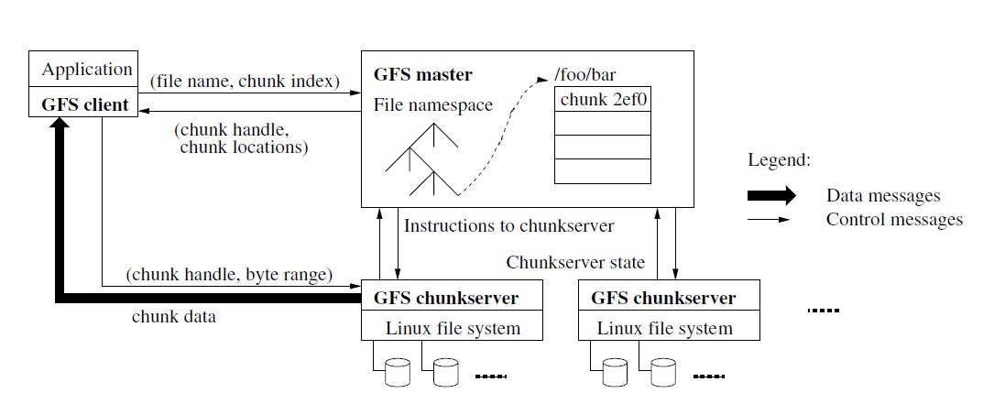
Architecture model
Notes:
这是模型图,可以看到data只有client和chunkserver之间传输

Slide 9
Question 0 –
How to design – isolation
large data and small control infos
  Separate metadata from data
Then we get the architecture model
  Client – where user code runs
  Master – metadata for the chunks
  Chunkservers – large data
Then some questions will be brought up
Notes:
这个初步的思路呢,就马上会带来新的问题:
比如针对single master

Slide 10
More questions –
single master
What if the single master fails?
  Single master is not single – we make replicas
Network bottleneck?
  Reduce the interaction with master
  Let the clients hold sth to interact with chunkservers more
  Cache – clients cache the chunk infos
  Let the chunkservers can interact more with each other
  Primary and secondary
Too much metadata to hold
No disks! All in memory!
Notes:
Single master 宕掉怎么办?备份
Single master单节点会不会成为网络瓶颈?针对这一点,我们减少master的交互.

Slide 11
Question 1 –
Too much metadata
Too much metadata to hold and we need
No disks! All in memory!
Traditional block is too small
Let the chunk size be 64MB

Slide 12
Benefits –
chunk size : 64MB
Larger chunk, less metadata
  Master maintains less than 64B of metadata for 64MB chunk
  1 TB chunks : < 1 MB metadata
  1 PB chunks : < 1 GB metadata
Less interactions between client and master
One continuous TCP connection during one chunk
One disadvantage
  little files with one chunk
  might make the chunkserver hotspot

Slide 13
So we get “chunk”
Files are divided into chunks
Replicated over chunkservers, called replicas
Unique 64-bit chunk handles
Chunks as Linux files

Slide 14
Question 2 –
What to hold in master
Metadata :
  The file and chunk namespaces
  Mapping from files to chunks
  Locations of each chunk’s replicas
All in memory
first two kept persistent by operation log
Get locations when startup and with heartbeat
  Change too often

Slide 15
Question 2.1 –
Why operation log?
We need reliability and ability to recovery
Master might need restart, might fail
Critical historical logs must be kept
  In disks
  By multiple servers
In addition to the logs, we need to
Checkpoint
When checkpointing, create a new operation log and start a new checkpointing thread

Slide 16
Question 3 –
What master does
Chunk creation
Re-replication
Garbage collection

Slide 17
Question 3 –
What master does
Chunk creation
  Low disk usage
  Limit recent creations
  Different racks
Re-replication
Garbage collection

Slide 18
Question 3 –
What master does
Chunk creation
Re-replication
  Priority
  2 failure > 1 failure
  Live > deleted
  Blocking > not blocking
Garbage collection

Slide 19
Question 3 –
What master does
Chunk creation
Re-replication
Garbage collection
  Does not delete immediately unless deleted twice
  Why?
  Simple and amortized(background activity, done only when free)
  How?
  After deleted, file is renamed to a hidden name
  Deleted after 3 days
  Can be undeleted and read

Slide 20
Architecture model

Slide 21
Question 4 –
Namespace Management and Locking
We need concurrency, so we need locking
No per-directory data structure.
No hard or symbolic links
Namespaces are represented as a lookup table mapping full pathnames to metadata
  Prefix compression
Each master operation acquires a set of locks before it runs

Slide 22
Question 4 –
Example of Locking Mechanism
Preventing /home/user/foo from being created while /home/user is being snapshotted to /save/user
  Snapshot operation
    Read locks on /home and /save
    Write locks on /home/user and /save/user
  File creation
    read locks on /home and /home/user
    write locks on /home/user/foo
  Conflict locks on /home/user

Slide 23
Architecture model

Slide 24
Question 5 –
How to minimize master interactions
Master – too much involvement!
Between master and client, we use cache.
Then what about master and chunkservers?
Then give more power to chunkservers!
Lease!

Slide 25
Question 5 –
Lease: to minimize master interactions
Master grants a lease to a chunk – primary chunk
Primary chunk picks the mutation order, which secondary chunks will follow.
A lease is about 60s, extension requests can be piggybacked on HeartBeat message.
Then we get the more detailed picture for the architecture model.

Slide 26
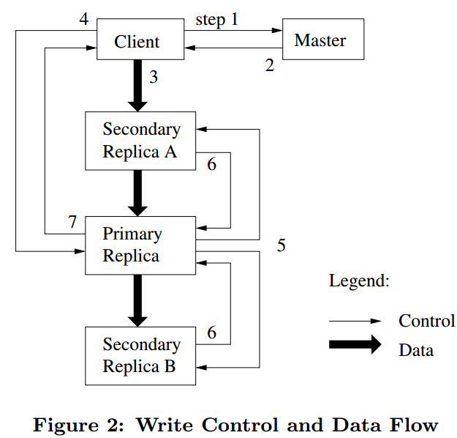
Question 6 –
How the components interact
Step1:
Asks which chunkserver holds lease and locations of all replicas.
If no lease, grant one.

Slide 27
Question 6 –
How the components interact
Step2:
Master replies.
Client caches locations, contact master again only when prim unreachable or prim is not prim.

Slide 28
Question 6 –
How the components interact
Step3:
push data to all replicas.
Carefully picked chain.
Linearly,
Pipelining.
Full duplex

Slide 29
Question 6 –
How the components interact
Step4:
After 3 totally done.
Client sends write request to prim.
Prim applies mutations.

Slide 30
Question 6 –
How the components interact
Step5:
Prim forward the request to all other replicas.
Others apply.

Slide 31
Question 6 –
How the components interact
Step6:
Reply to prim

Slide 32
Question 6 –
How the components interact
Step7:
Prim replies to client.
If any error, client retires.
(some secondary replica might fail, inconsistency happens.)

Slide 33
Some detailed questions to discuss

Slide 34
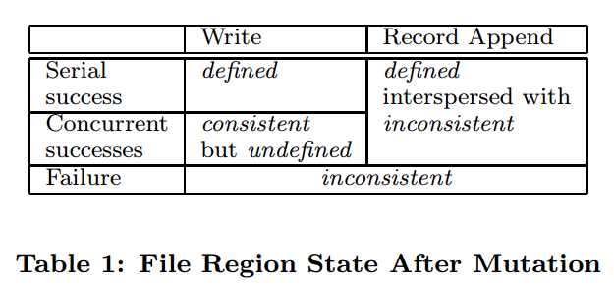
Question 7 –
How is the consistency model?
Relaxed consistency model
Two types of mutations
  Writes
    Cause data to be written at an application-specified file offset
  Record appends
    Operations that append data to a file
    Cause data to be appended atomically at least once
    Offset chosen by GFS, not by the client

Slide 35
Question 7.1 –
How to append records atomically?
Be similar to the preceding graph
But checks if the chunk will exceed 64MB
  If so, it pads and let the client to append again to a new chunk
  Limited within ¼ size once
What if one secondary replica fails?
  Client retries. Who failed pads and begin at the same offset.
  As a result, replicas of the same chunk may contain different data, possibly including duplicates of the same record.
  But GFS guarantees the data is written at least once and at the same offset.

Slide 36
Question 7.2 –
Then how to explain the Table 1?
States of a file region after a mutation
  Consistent
    All clients see the same data, regardless which replicas they read from
  Defined
    consistent + all clients see what the mutation writes in its entirety
  Undefined
    consistent +but it may not reflect what any one mutation has written
  Inconsistent
    Clients see different data at different times

Slide 37
Question 8 –
What about snapshot?
Goals
  To quickly create branch copies of huge data sets
  Or to easily checkpoint the current state
First revoke leases on chunks involved
Then write operation will ask master and master will
Copy-on-write
locally

Slide 38
Question 9 –
How to know which replica is stale
Version!
Replica version updated when:
  Master grant a new lease
  Each mutation is applied

Slide 39
Question 10 –
Fault Tolerance and Diagnosis
Fast Recovery
  Operation log
  Checkpointing
Chunk replication
  Each chunk is replicated on multiple chunkservers on different racks
Master replication
  Operation log and check points are replicated on multiple machines
Data integrity
  Checksumming to detect corruption of stored data
  Each chunkserver independently verifies the integrity
Diagnostic logs
  Chunkservers going up and down
  RPC requests and replies

Slide 40
Background –
for measurements
Two clusters within Google
  Cluster A: Research & Development
    Read and analyze data, write result back to cluster
    Much human interaction
    Short tasks
  Cluster B: Production data processing
    Long tasks with multi-TB data
    Seldom human interaction

Slide 41
Measurements
Read rates much higher than write rates
Both clusters in heavy read activity
Cluster A supports up to 750MB/read, B: 1300 MB/s
Master was not a bottle neck
Cluster | A | B
Read rate (last minute) Read rate (last hour) Read rate (since restart) | 583 MB/s 562 MB/s 589 MB/s | 380 MB/s 384 MB/s 49 MB/s
Write rate (last minute) Write rate (last hour) Write rate (since restart) | 1 MB/s 2 MB/s 25 MB/s | 101 MB/s 117 MB/s 13 MB/s
Master ops (last minute) Master ops (last hour) Master ops (since restart) | 325 Ops/s 381 Ops/s 202 Ops/s | 533 Ops/s 518 Ops/s 347 Ops/s

Slide 42
Measurements
Recovery time (one chunkserver killed)
  15,000 chunks containing 600GB are restored in 23.2 minutes (replication rate ≅ 400MB/s)
Recovery time (two chunkserver killed)
  Each containing 16,000 chunks and 660GB
  266 chunks – single replica
  Higher priority – 2 minutes
  (Total time not told)

Slide 43
Benefits and Limitations
Simple design with single master
Fault tolerance
Custom designed
Only viable in a specific environment

Slide 44
Conclusion
Different than previous file systems
Satisfies needs of the application
Fault tolerance

Slide 45
Thanks!
Welcome to ask and discuss!

